Slide 1
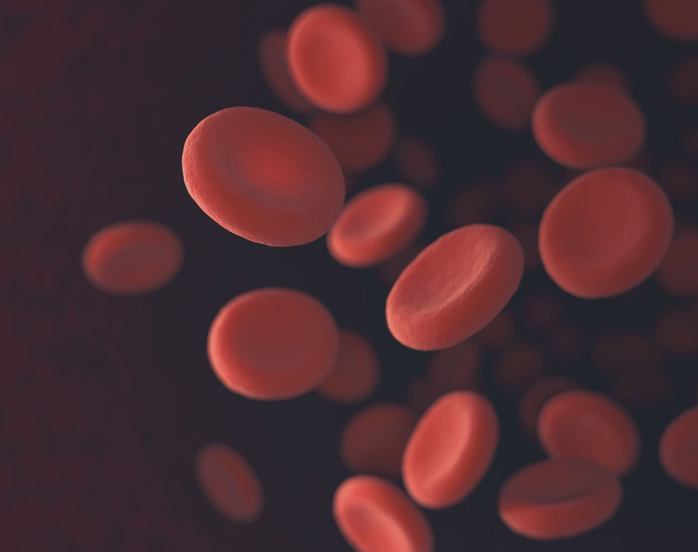
BLOOD CELLS COUNTING USING COMPUTER VISION TECHNIQUES
NAME: KOKILA K
ROLLNO: 2019272016
GUIDE: Ms.G.Mahalakshmi

Slide 2
ABSTRACT
This paper proposes an automated method for counting of red blood cells using computer vision techniques. The traditional methods of blood analysis involve the manual counting of blood cells observed under the microscope. This method poses large dependency on the skills of the laboratory technician and can cause errors. The automated haematology analysers, on the other hand, produce accurate results.
However, these equipments are very costly and difficult to move once installed. They require trained experts to operate this equipment. The proposes method provides a low cost and portable solution for obtaining the red blood cell count using a image processing algorithm that works on the images captured by a microscope with considerable accuracy.
The method minimizes the cost of the equipment while promoting mobility of the device for relocation to remote parts for pathological tests, all instructions and details of out will be printed to excel sheet with patient name as a report, so we manage more patient 's report effectively and handle with safe.

Slide 3
INTRODUCTION
The manual counting of blood cells observed under the microscope. This method poses large dependency on the skills of the laboratory technician and can cause errors. The automated haematology analysers, on the other hand, produce accurate results.
However, these equipments are very costly and difficult to move once installed. They require trained experts to operate this equipment. The proposes method provides a low cost and portable solution for obtaining the red blood cell count using a image processing algorithm that works on the images captured by a microscope with considerable accuracy.
Then it is digitally processed with software and the result is displayed immediately.

Slide 4
PROBLEM STATEMENT
Mainly, Variations in the shape and irregularities cannot be detected.
Sometimes, inaccurate results are produced through manual counting method and it adds stress to the technician while submitting the report. Therefore, counting overlapping cells is a major problem. To address this problem, this paper uses digital image processing technique to minimize the errors and reduce the stress overload.
This method of counting RBC helps in diagnosing various diseases such as anaemia, polycythemia etc .This paper introduces a cost effective automatic blood cell counting method using image analysis techniques and specifically aims at improving the results using Plane extraction and Counting techniques. The proposed system of Automated Blood Cell Count System.

Slide 5
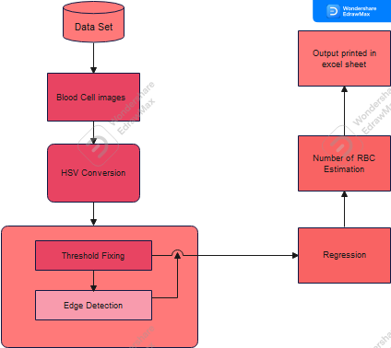
ARCHITECTURE DIAGRAM

Slide 6
Architecture Explain
RGB into HSV:
R,G,B are Co-related to the color luminance, We cannot separate color information from luminance. HSV or Hue saturation value is used to separate image luminance for color information.
Threshold define:
Threshold is used to define minimum and maximum size of the cell.
Edge Detections:
Edge detection is used to define shape of given images and make line between color variations.
Regression:
Regression used to predict shape of the cells.
Output:
Display the output to the excel sheet

Slide 7
THANK YOU

